Slide 1

COMPREHENSIVE SALES ANALYSIS & STRATEGIC RECOMMENDATIONS
Data-Driven Insights for Future Growth
S A HARI GANESH
NIIT DATA SCIENCE

Slide 2

Project Objectives
Sales Analysis
Customer Segmentation
Deep dive into overall sales performance and trends.
Understanding our customer base for targeted strategies.
Sales Forecasting
Product Performance
Predictive insights for future revenue planning.
Identifying top-performing and underperforming products.
Order & Stock Analysis
Overall KPI Analysis
Optimizing inventory and order fulfillment processes.
unified view of growth, performance, and gaps.

Slide 3
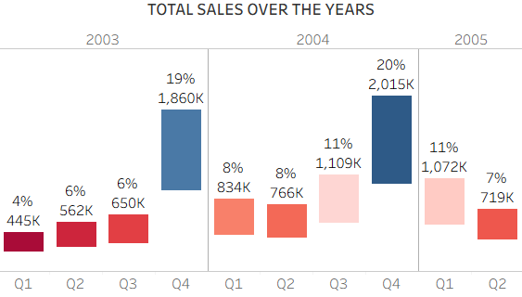
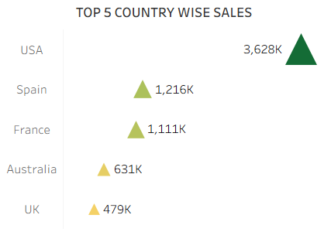
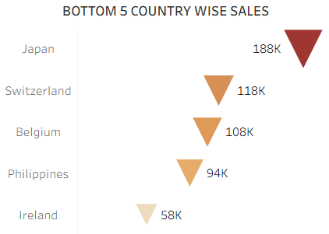
Sales Analysis
Q4 shows the highest sales across years (up to 20% share in 2004)
USA's contribution accounts for 36.2% of the total revenue.
Top 5 Countries by Sales

Slide 4
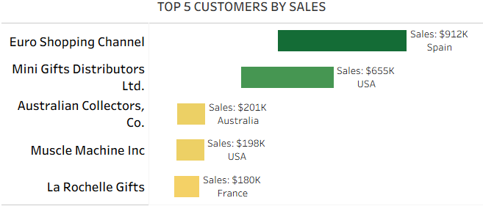
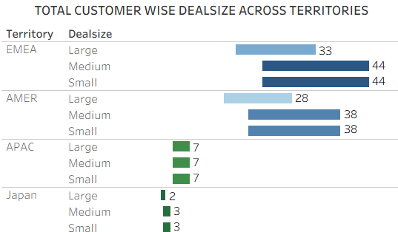
Customer Segmentation
Top 5 customers contribute 21.4% of total sales
APAC and Japan show smaller deal sizes with consistent counts across all categories.
EMEA and AMER territories dominate in deal size count, especially in medium and small categories.

Slide 5
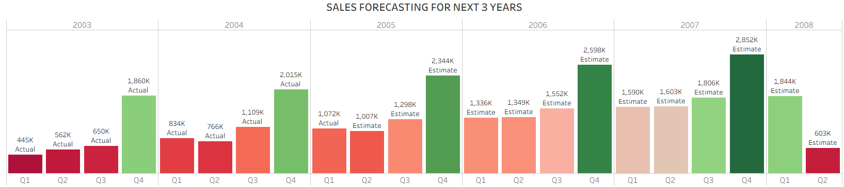
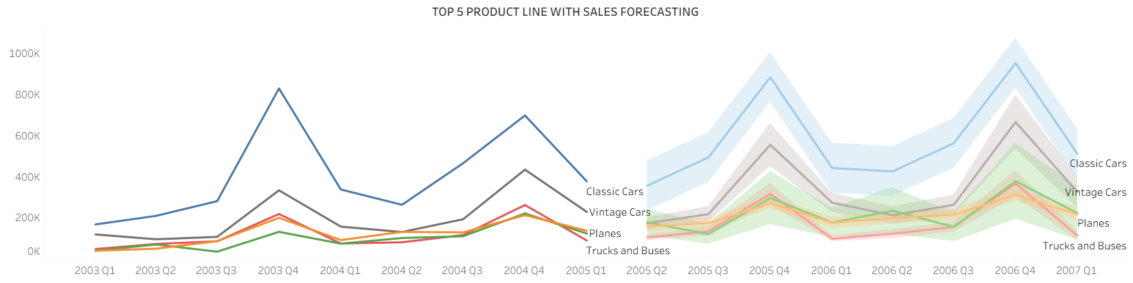
Sales Forecasting
Yearly sales are expected to increase by over 30% over the next three years.
Actual Sales ($K)
Estimated Sales ($K)

Slide 6
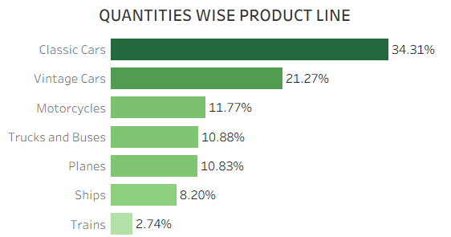
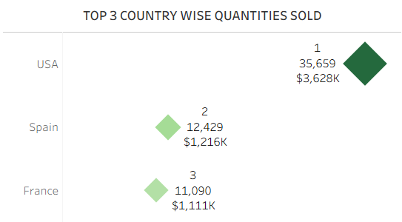
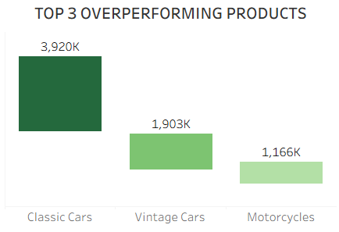
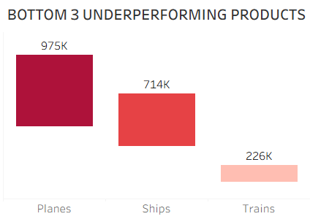
Product Performance Analysis
Classic Cars lead product sales with 34.3% share.
USA drives overall quantity sold with 67%
Trains underperform, representing just 2.7%

Slide 7
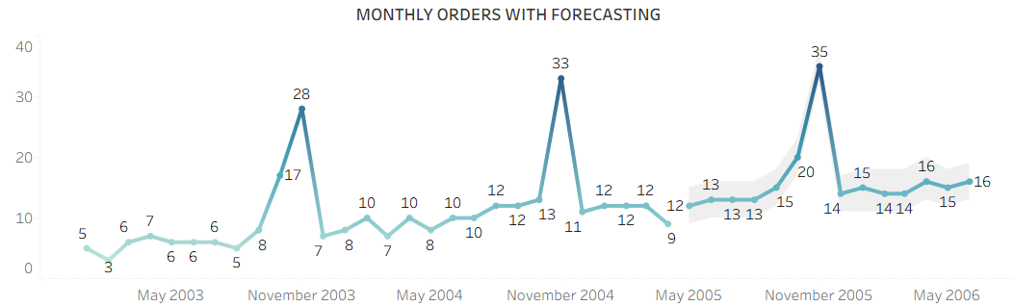
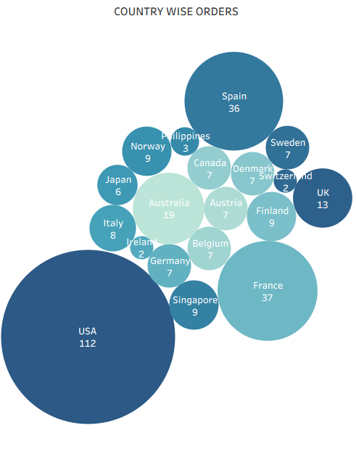
Order Analysis
307
323
Total Orders
Average Quantity per Order
USA dominates with 36.5% of total 307 orders.
Top 3 countries account for 60.3% (185) orders
November Prediction peaks with 35 orders in 2005

Slide 8




Overall KPI Analysis
$10.03M
99,067
92
$3,554
Total Sales
Total Quantities
Total Customers
Avg. Sales
1,077
3
$109K
7
Qty Per Customer
Orders Per Customer
Sales per Customer
Product Lines
We achieved over $10 million in sales from just 92 customers
Operating in 19 countries with 7 diverse product lines provides a solid foundation.
On average, each customer places 3 orders and purchases more than 1,000 items.
19
Total Countries

Slide 9






Business Recommendations
Dropout weak Products
Enhance Marketing
Festival Offers
Dropout or replace weak products like Trains, Ships, and Planes.
Develop and implement marketing strategies
Introduce festival and holiday offers for APAC and Japan regions
Customer Loyalty
Engagement Programs
Boost Brand Awareness
Implement loyalty programs to increase purchases and customer value.
Sponsor local events and engage in community initiatives to attract new customers.
Invest in brand awareness campaigns through advertising and engaging social media.

